Slide 1
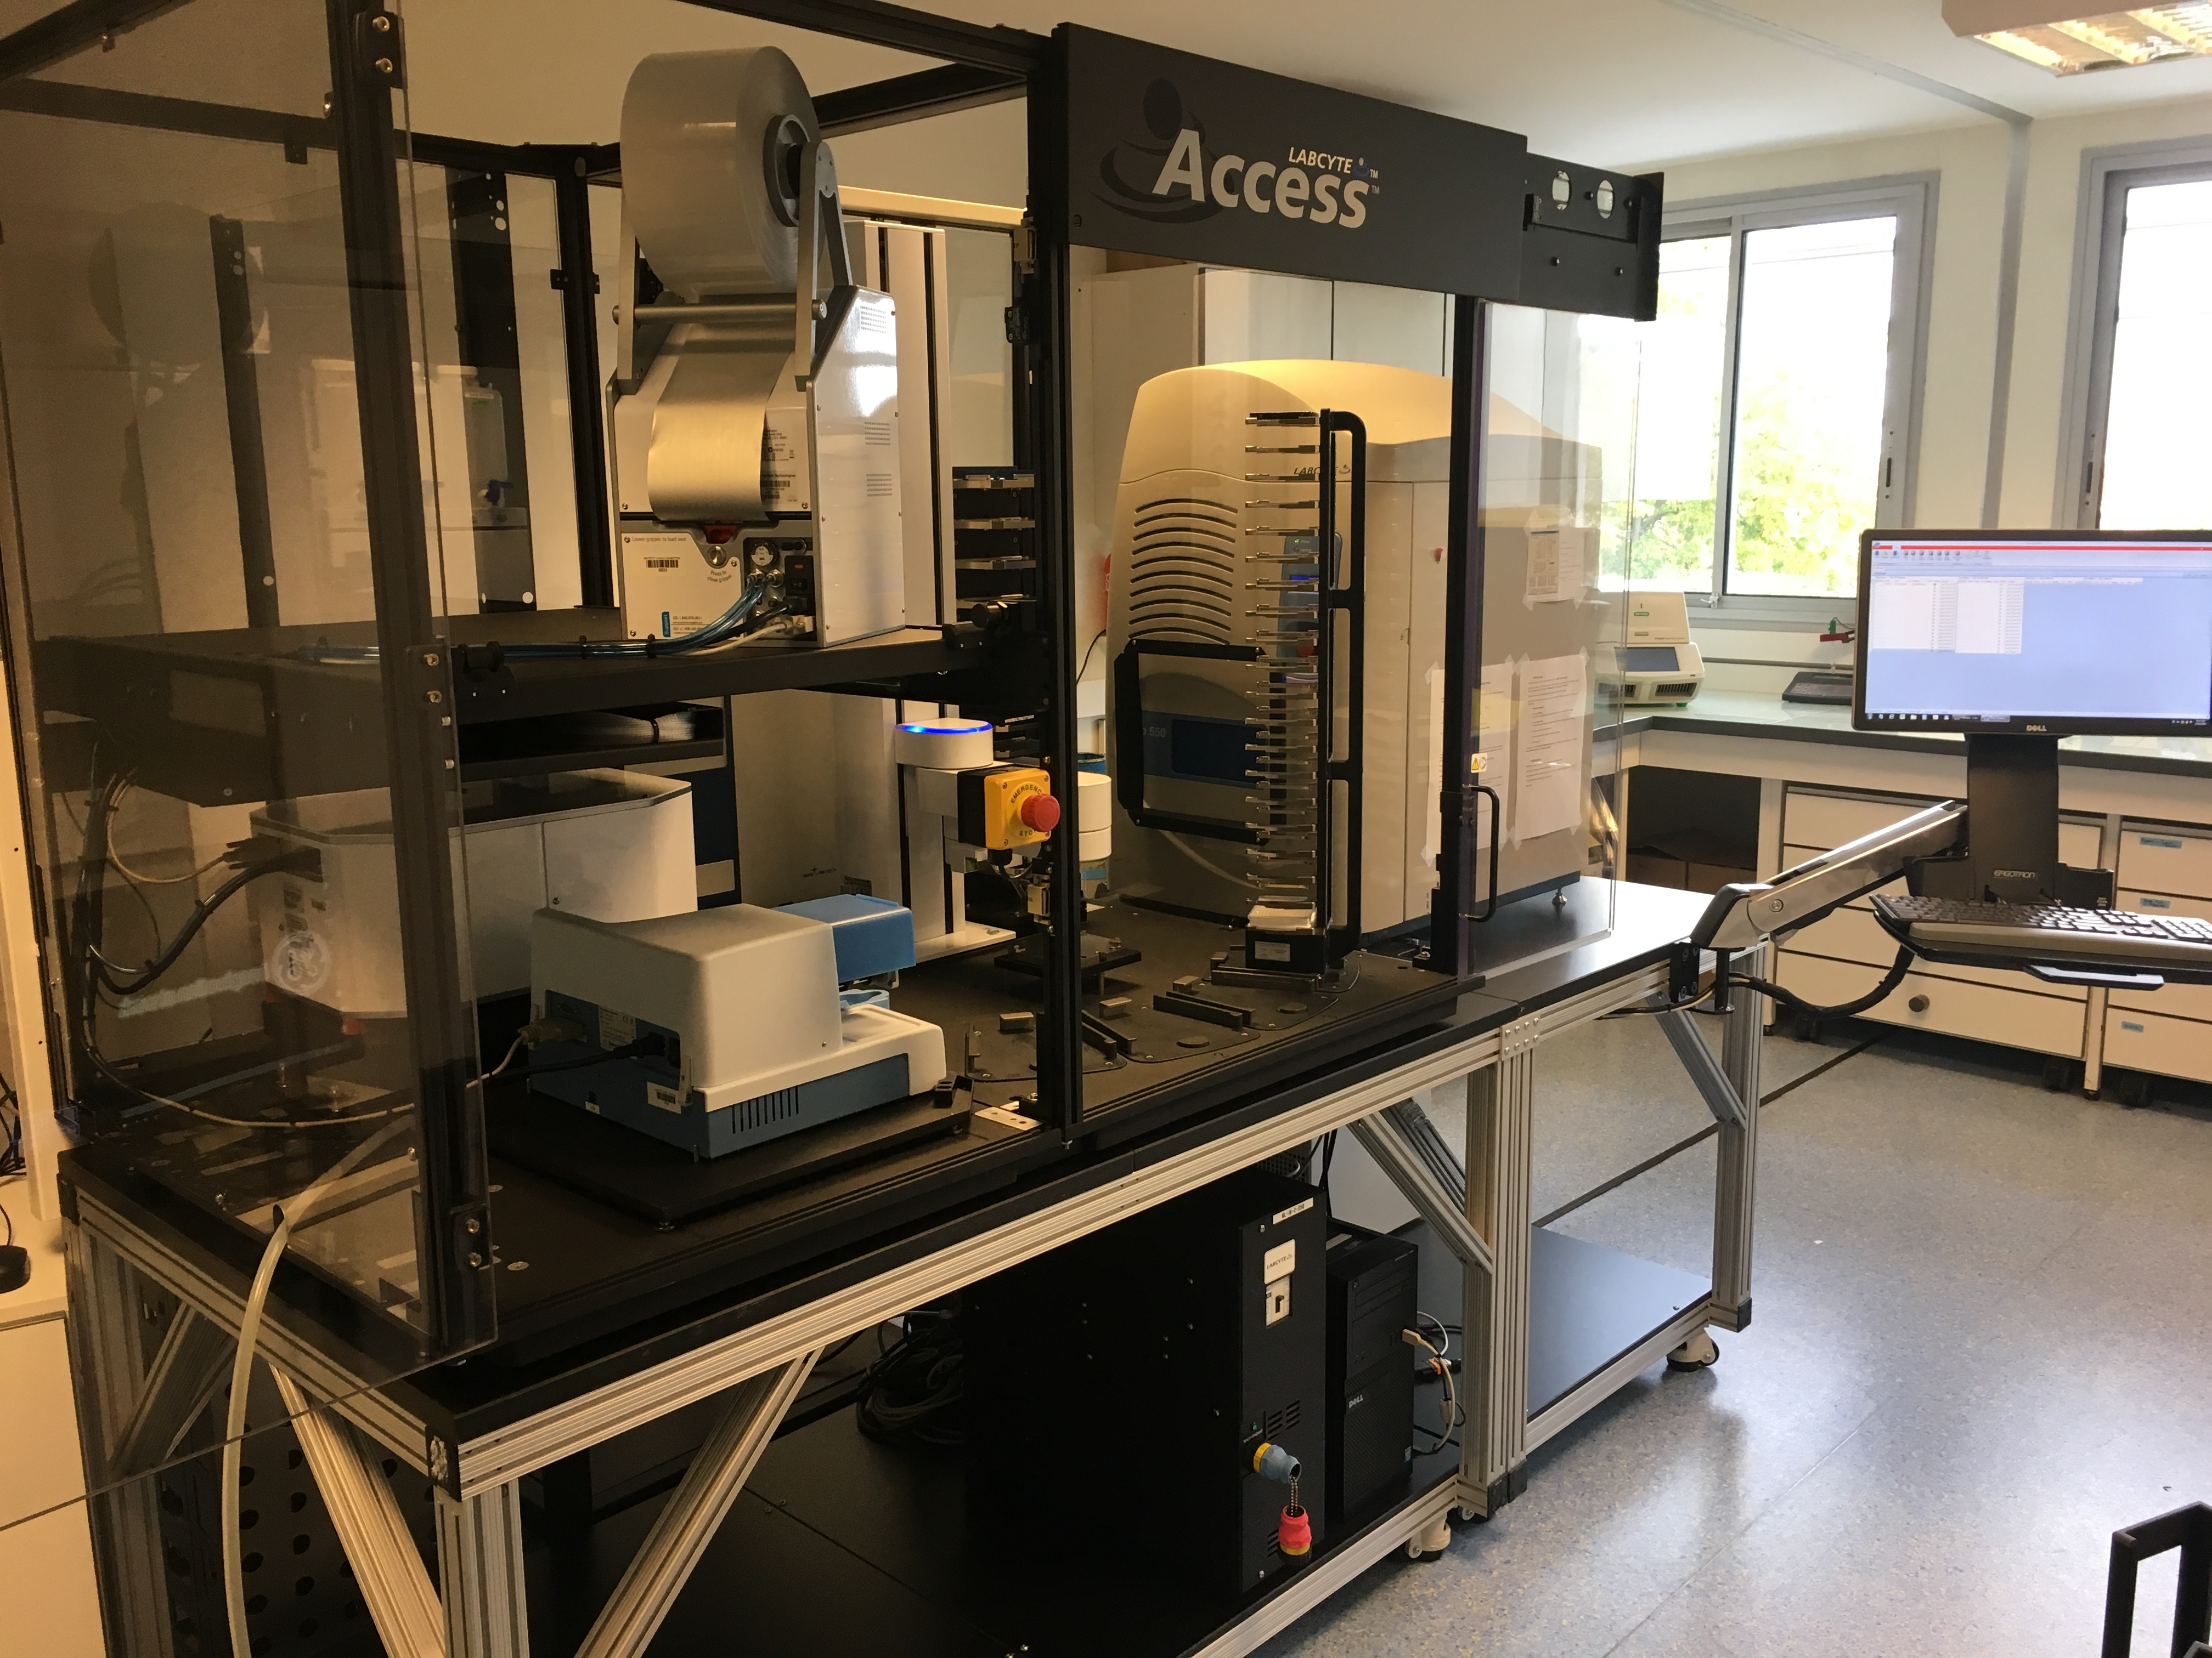
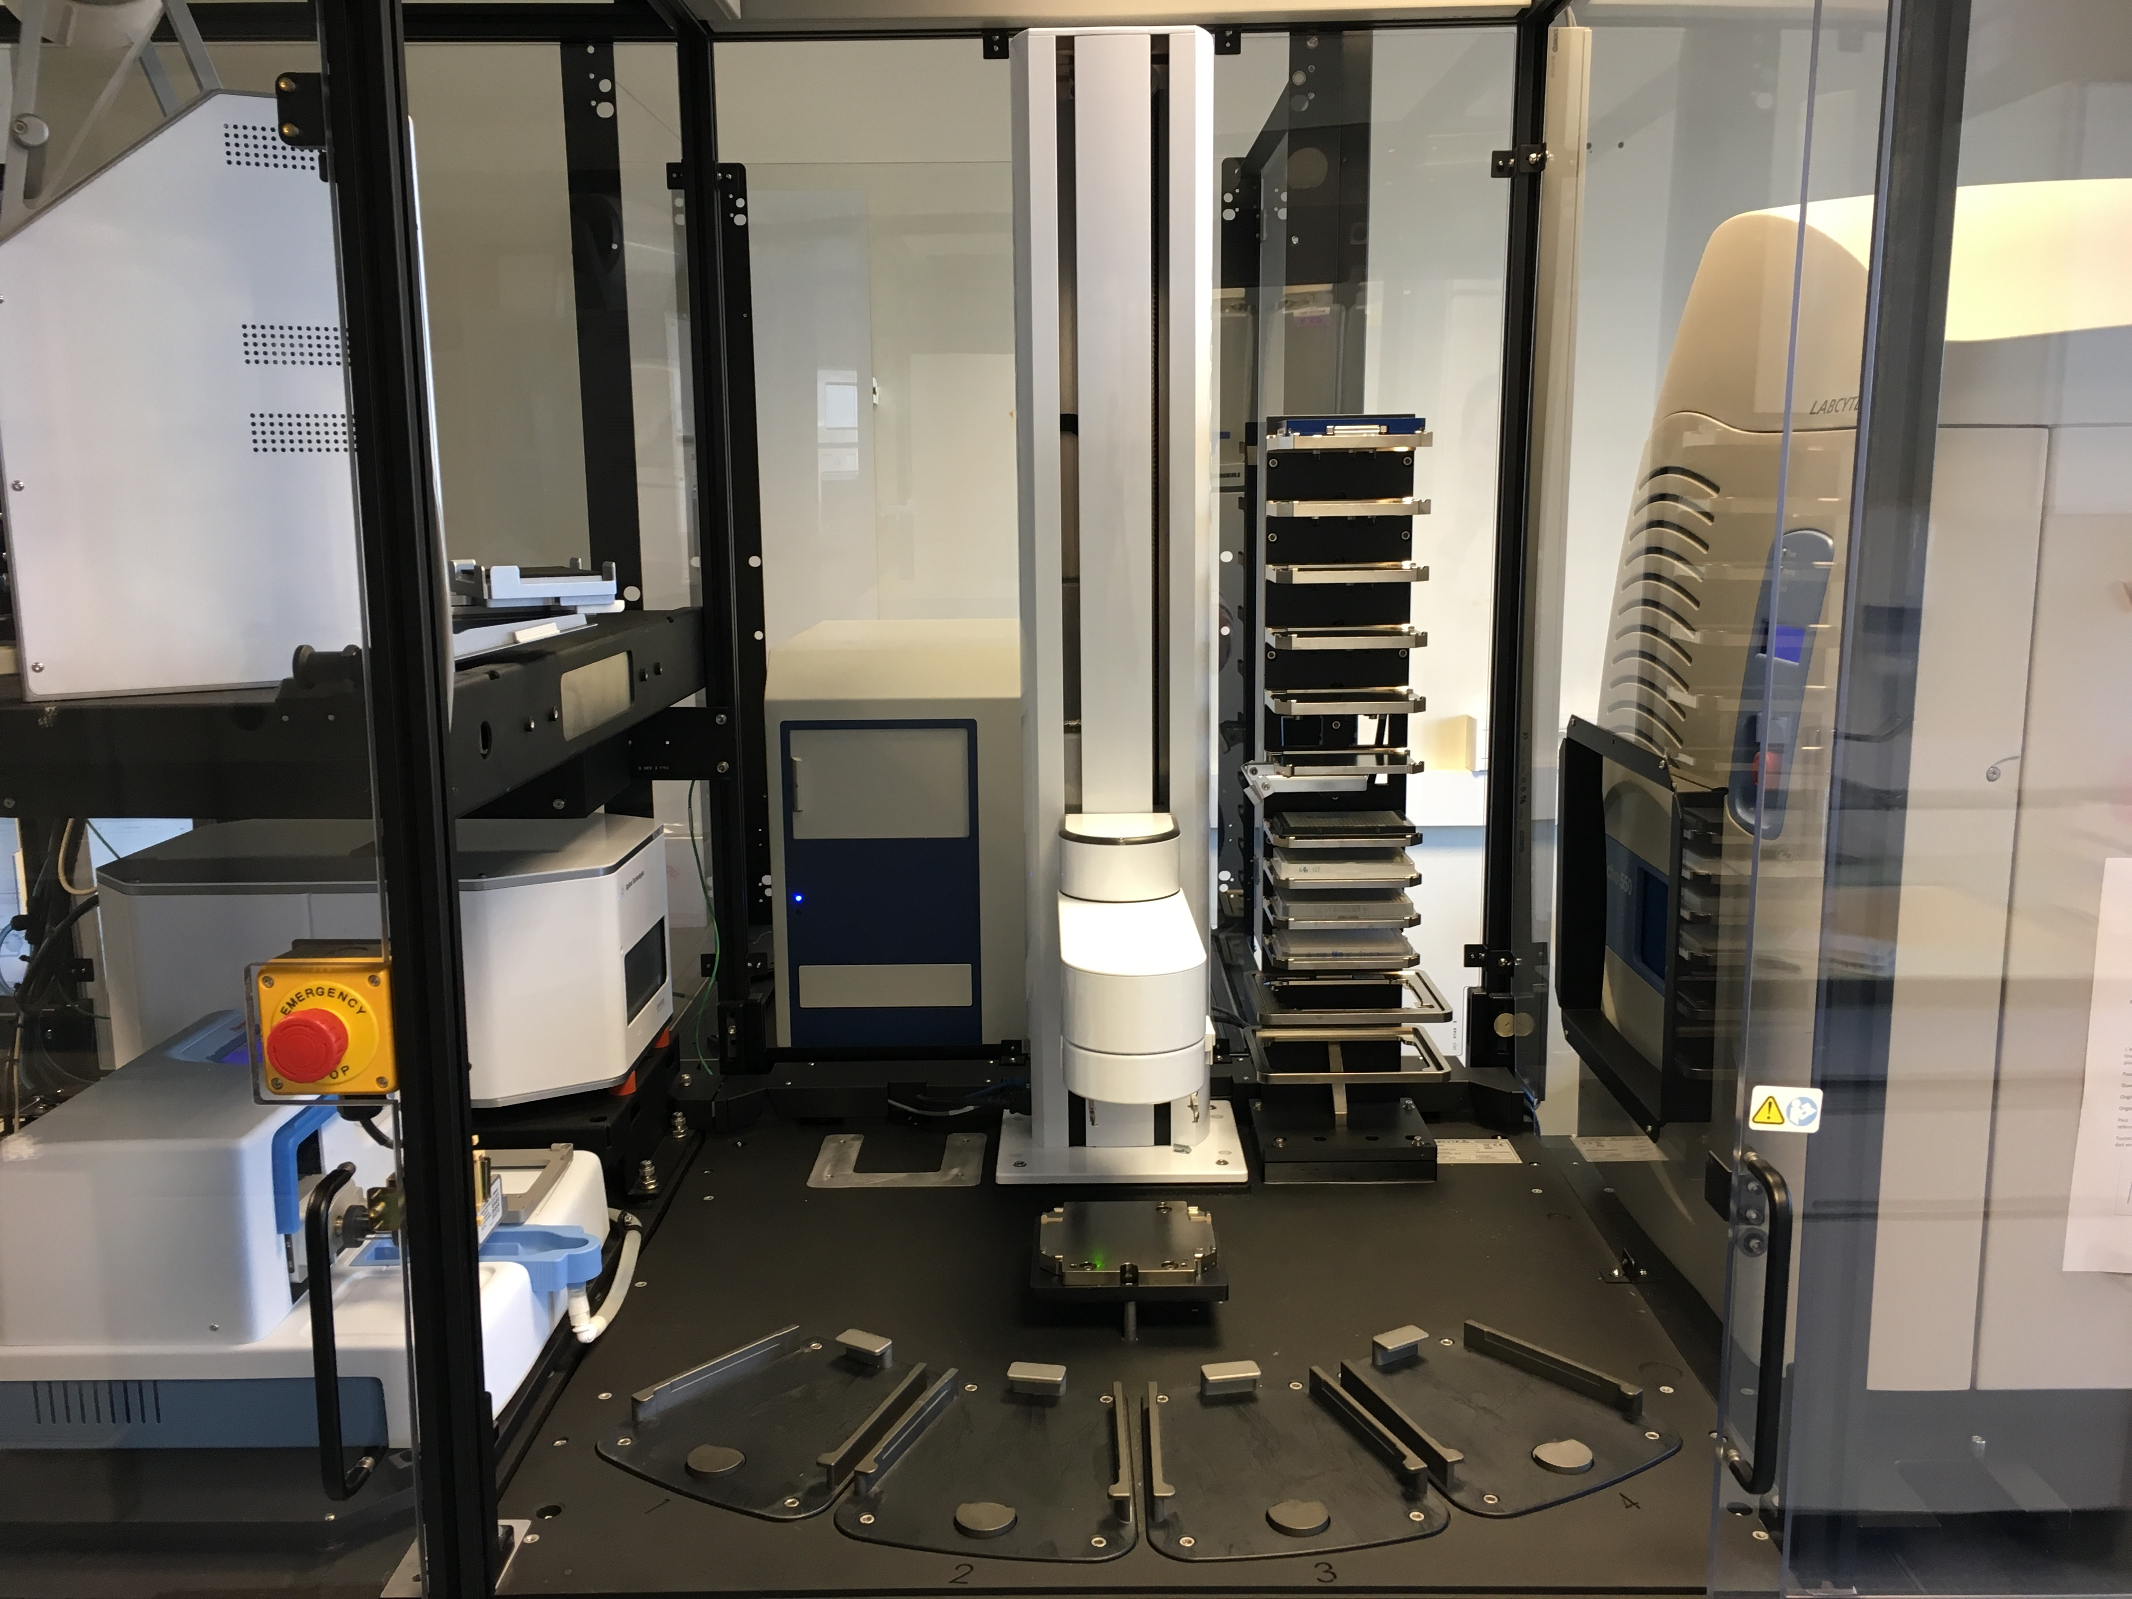
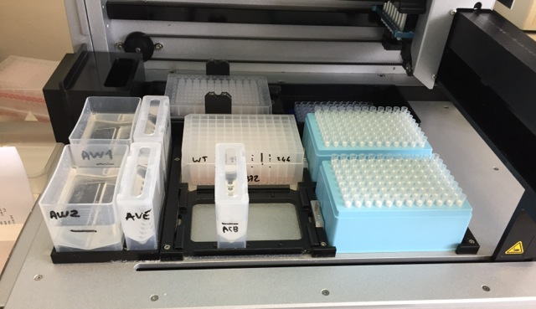
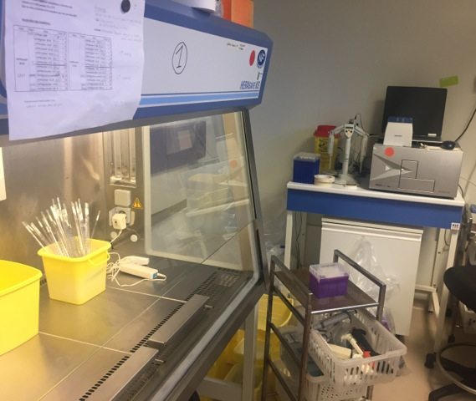
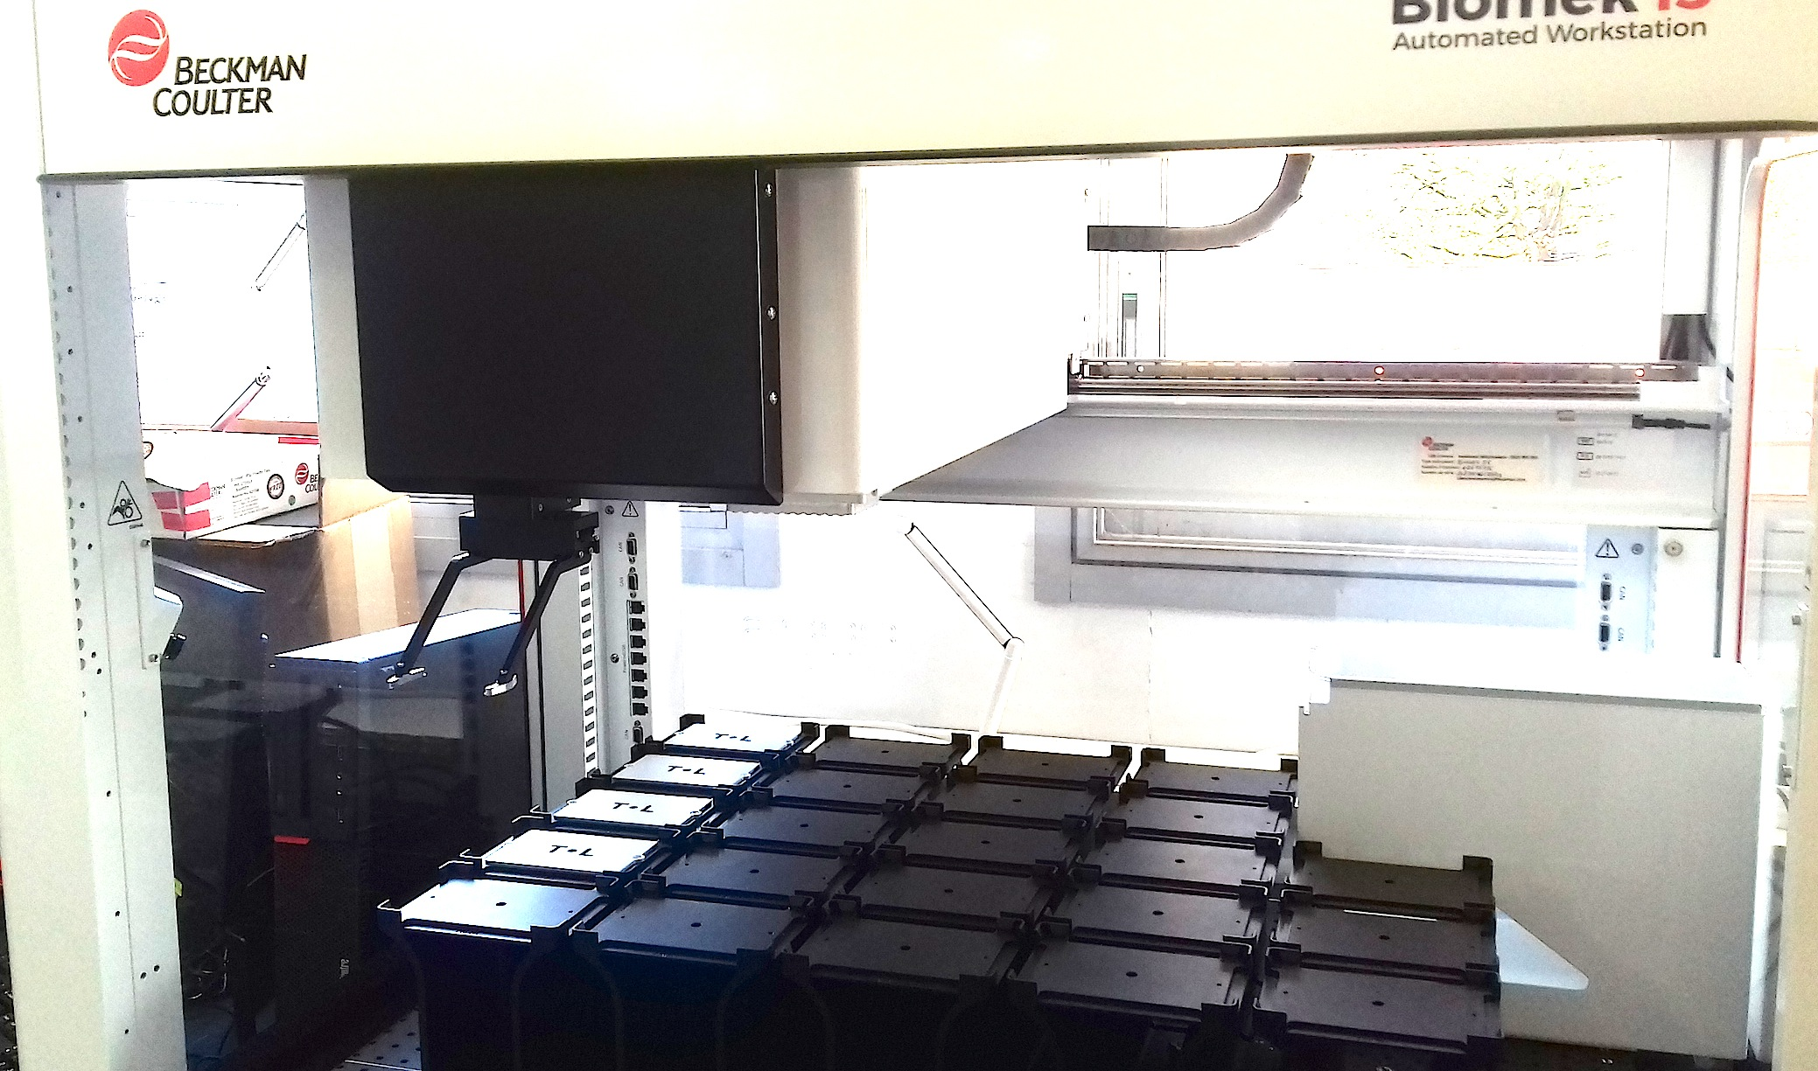
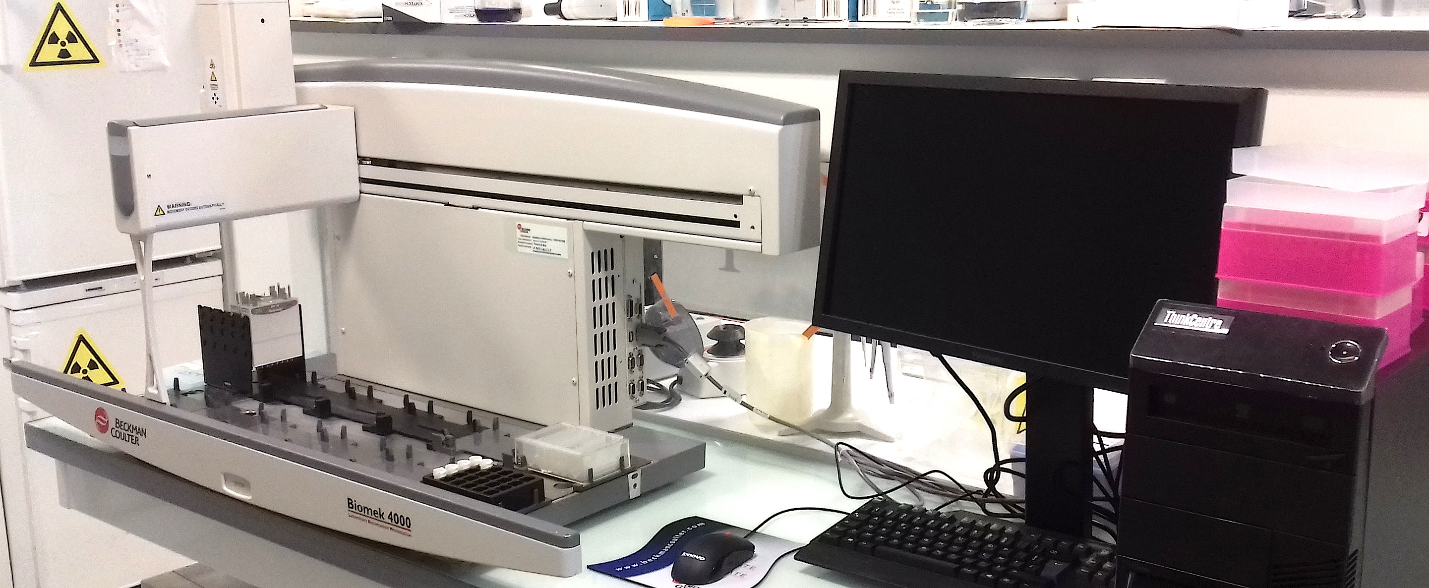
MArseille Screening Center : MaSC
https://www.afmb.univ-mrs.fr/MaSC/
Contact: Jean-Claude.Guillemot@univ-amu.fr
B.COUTARD³, C.DERVIAUX², C. EYDOUX¹, J.-C. GUILLEMOT¹,
X. MORELLI³, F.TOURET³ (in alphabetical order)
1 CNRS/AMU AFMB UMR 7257, Polytech case 925 bât B, 163 av. de Luminy, 13288 Marseille
2 CNRS/INSERM/AMU/ Institut Paoli-Calmettes, CRCM CS30059, 13273 Marseille cedex 09
3 UMR 190, Unité des virus Emergents, Faculté de Médecine, 27 Bd J. Moulin 13005 Marseille
The Marseille Screening Center (MaSC) brings together 3 platforms specialized in the development and implementation of new technologies dedicated to the screening of libraries, the drug design and the discovery of new bioactive molecules. MaSC is a major asset involved in scientific research in the field of antiviral and anticancer compounds on protein targets, protein/protein or protein/ligand interactions and infected cells.
HiTS
Screening Platform from Marseille Timone (PCVMT)
protein-protein or protein-ligand interaction inhibitors:
Protein production and purifications
Developement and miniaturization of assays
Robotized High throughput screening
Chemoinformatic and molecular modeling
Antiviral target in cellulo :
Screening against viruses (wild type or recombinant)
Resistance assays
xavier.morelli@inserm.fr
Bruno.Coutard@univ-amu.fr
Screening Platform from Marseille-Luminy (PCML)
Antiviral target in vitro :
Proteins production and purification
Developement and miniaturization of assays
Robotized screening
Biochemical characterization of hit compounds
Jean-Claude.Guillemot@univ-amu.fr
Molecular modeling (3D-Model, structural alignment, virtual mutagenesis)
Molecular dynamics simulations
Docking (protein/protein ; protein/ligand)
In silico screening (High throuput docking, pharmacore filtering, similarity research)
Medecinal chemistry (Hit to lead optimization, QSAR…)
Database management (In house database, dedicated database)
High throughput screening (miniaturization , 384/1536 wells,assays developments)
Protein-protein or protein-ligand inhibitors screening
- Biophysical characterization by orthogonal techniques (TSA,ITC…)
Protein production and purifications
HiTS
Production and purifications of a collection of viral enzymes
Enzymes inhibitors screening
(assays developments (radioactivity, fluorescence, HTRF…), miniaturization (96/384 wells))
Protein-protein inhibitors screening
Biophysical characterization by orthogonal techniques (TSA…)
Providing chemical libraries (in house or oriented chemical libraries)
PCML
Your project
In cellulo screening in NSB3 (P3/P3+)
(infected cells with wild-type or recombinant virus, resistance assays…)
PCVMT
In order to speed-up the discovery process of bioactive compounds, we have developed a screening workstation center, dedicated both to academic and industrial prestations and/or collaborations . The combination of our experiences and know-how creates a dynamic interface conducive to the development and optimization of your projects.

