Slide 1











Marseille Screening Center : MaSC
High Throughput Screening (HiTS)
Xavier MORELLI
Viral screening Platform Marseille-Timone (PCVMT)
Xavier de LAMBALLERIE
Screening Plateform Marseille-Luminy (PCML)
Jean-Claude GUILLEMOT

Slide 2
What can MaSC do for you?
HiTS
Molecular modeling
(3D-Model, structural alignement, virtual mutagenesis)
(protein/protein, protein/ligand)
In silico screening
(hight throughput docking, similarity research...)
Medicinal Chemistry
("hit to lead » optimization , Q-SAR)
Database management
(« home made » or dedicated)
On IPCdd :
- Screening of inhibitors targeting protein-protein interactions (with HTRF or Alphascreen assay)
On INT-3D :
Cellular screening
(infected cells by wild-type virus or clinical isolates, resistance assays...)
PCVMT
Your project
Production and purifications of a collection of viral enzymes
Enzymatic screening (assays development and miniaturisation)
Screening of inhibitors targeting protein/protein or protein/ligand interactions
Biochemical characterization
Libraries supply (« home made", dedicated)
PCML

Slide 3






MaSC
HiTS
Scientific manager : Xavier MORELLI
Operational manager : Carine DERVIAUX
Aix-Marseille université – CNRS – INSERM - Institut Paoli-Calmettes - CRCM CS30059, Marseille

Slide 4
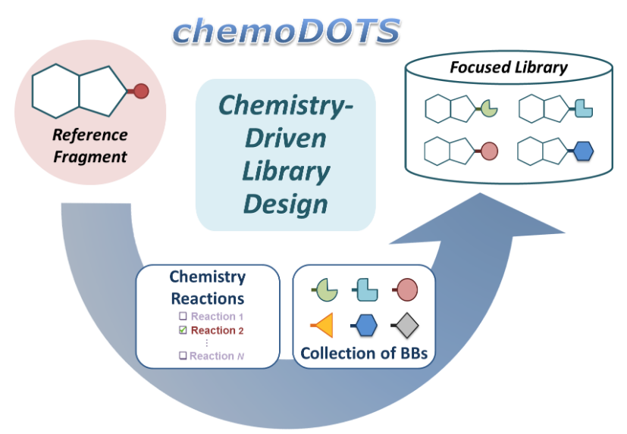
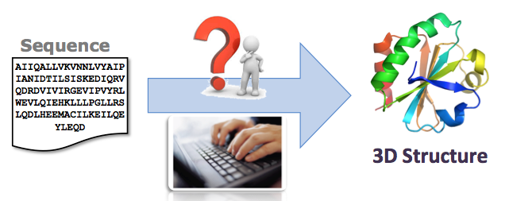


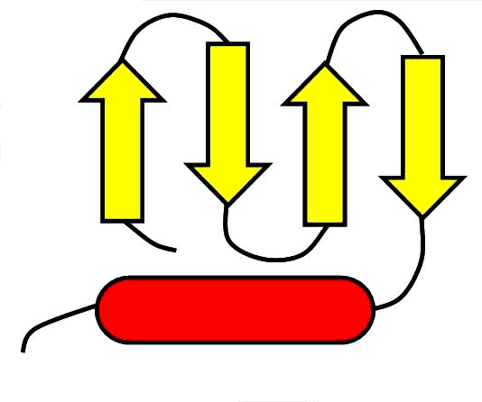

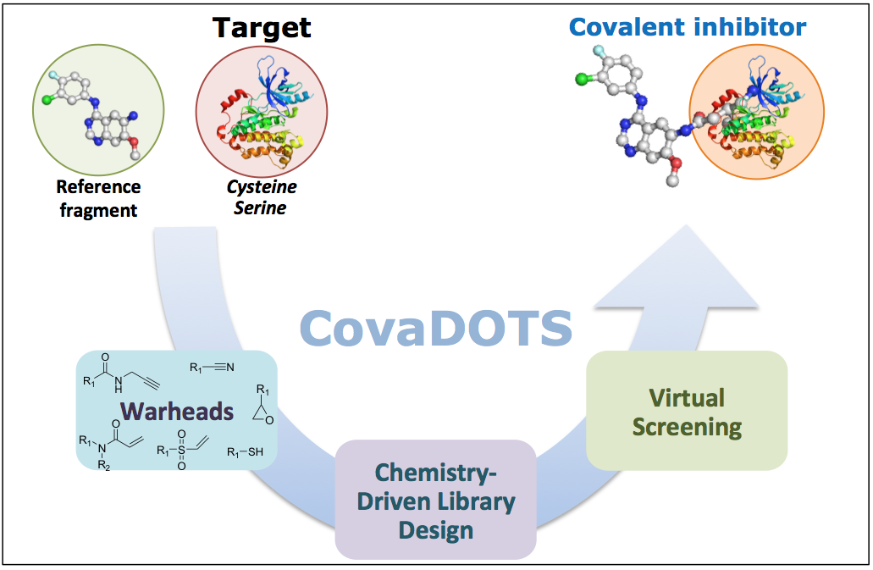
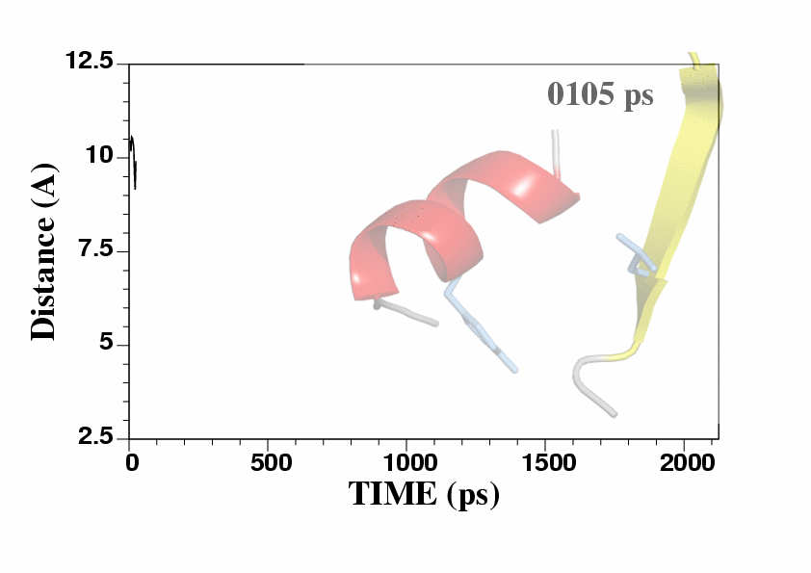
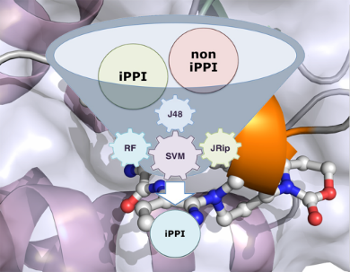
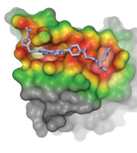
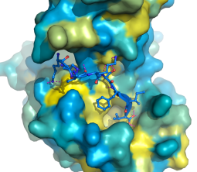

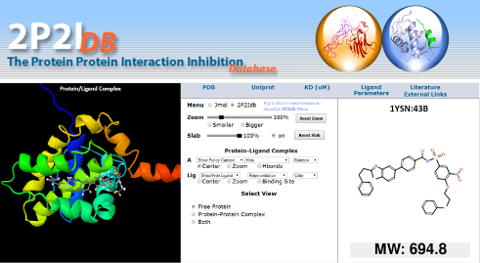
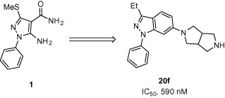

Methodologies @Int3D
Developments @Int3D
Homology Modeling
0
Growing Optimization
DOTS
ChemoDOTS
http://chemodots.marseille.inserm.fr/
Molecular Dynamics
Covalent Inhibitors
CovaDOTS
CovaGrow
CovaLink
Virtual Screening
Fragment Libraries
Docking
Pharmacophoric Filtering
Focused Libraries
SAR
Fr-PPI_{CHEM}
Scaffold Hopping
SAR-by-Catalogue
Hit-to-Lead Optimization
10,314 cpds
Databases/Servers
http://2p2idb.cnrs-mrs.fr/
Hit
Lead
2P2IDB

Slide 5
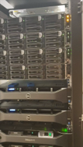







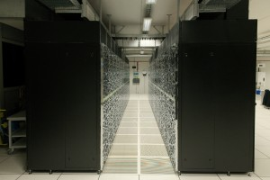



Software and Hardware @Int3D
Dedicated Software
Computing Resources
In house
Cluster
504 CPUs
NAS 2x145 To
CINES
National Center
National Supercalculator/HPC

Slide 6

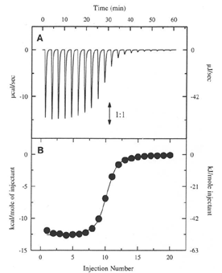
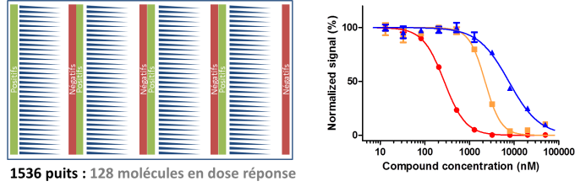
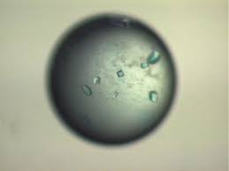
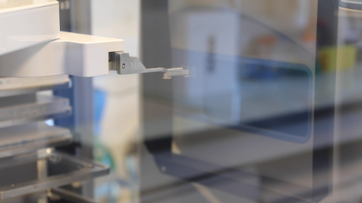
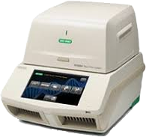
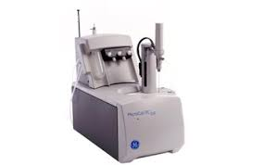
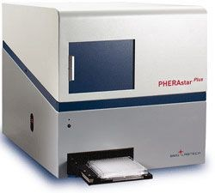

INT3D – IPC Drug Discovery
High-throughput screening
In vitro PPI Inhibition : 1536 wells HTRF plates
Selection
Dose-response
Orthogonal validation
ITC
In vitro direct interaction : TSA plates 384
In cellulo PPI : NanoBRET plates 384
Counter-screen
Xray
Libraries :
Fr-PPIChem : 10314 compounds
Libraries management with a Chemaxon database
Automated analysis with an « in house » LIMS
Biorad CFX384
ITC200
Pherastar BMG Labtech
Labcyte

Slide 7

MaSC
Screening Plateform Marseille-Luminy (PCML)
Scientific manager : Jean-Claude GUILLEMOT
Operational manager : Cécilia EYDOUX
Laboratoire Architecture et Fonction des Macromolécules Biologiques (AFMB) – UMR7257 – Aix-Marseille université - CNRS - Marseille

Slide 8
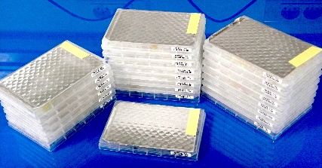
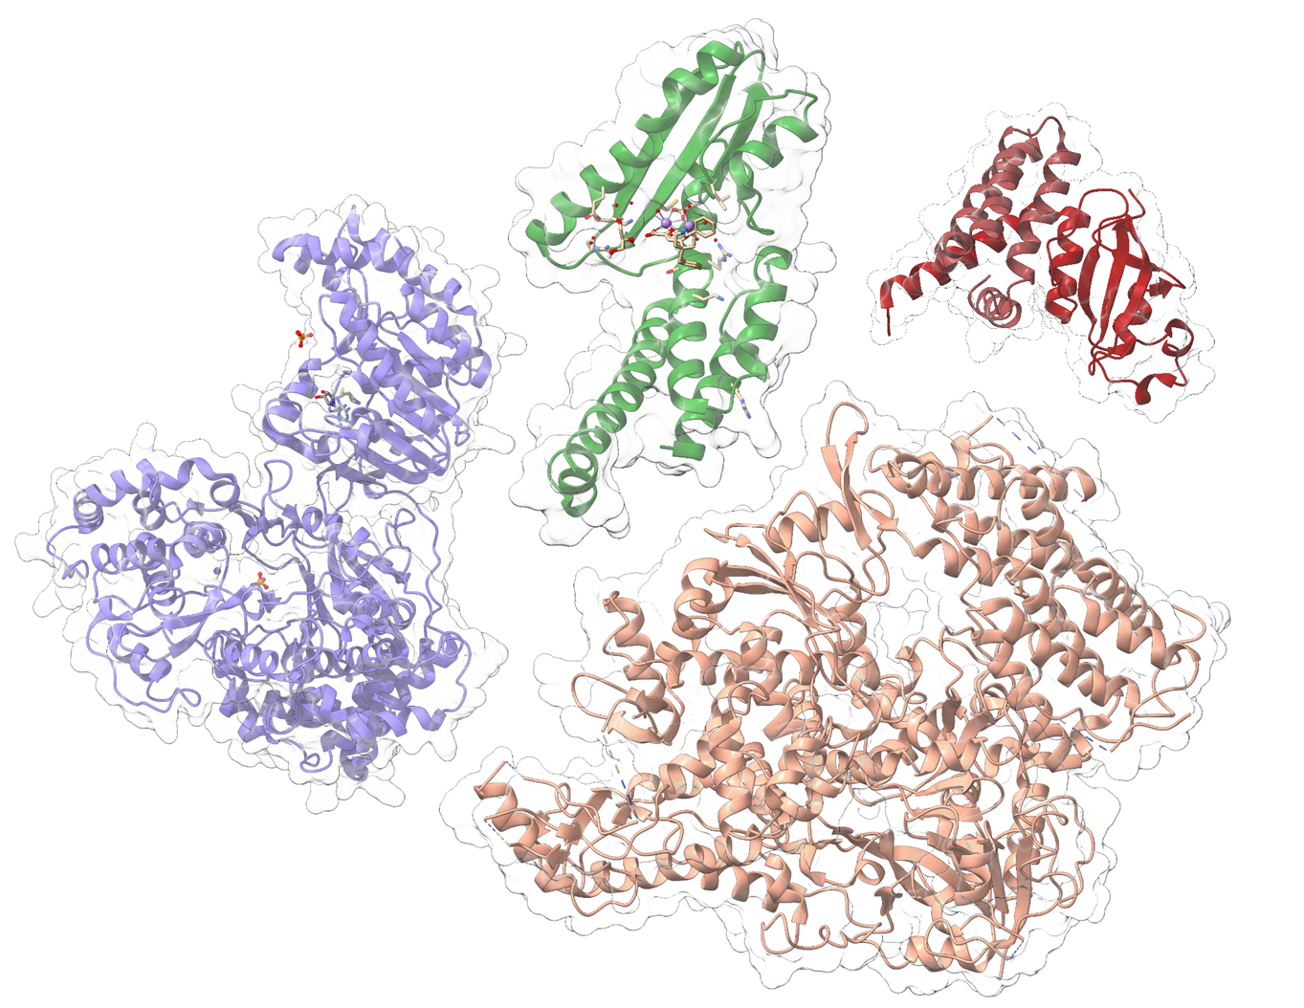
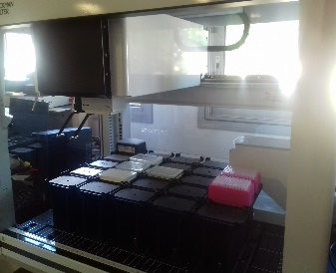
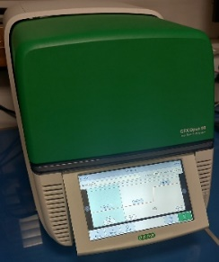
Screening Platform Marseille-Luminy (PCML)
Expertise and know-how
Chemical libraries
>76 000 compounds
Academic and commercial librairies
PCML
Enzymes library
Production and purification of
target proteins
(Flavivirus and Coronavirus)
Screening – IC50
Fluorescent and radioactive assays on robotized systems
Orthogonal Assays
- IC50s with detergent
- Thermalshift assay

Slide 9
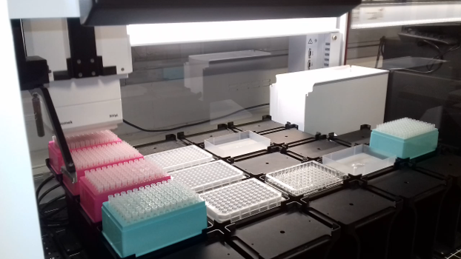
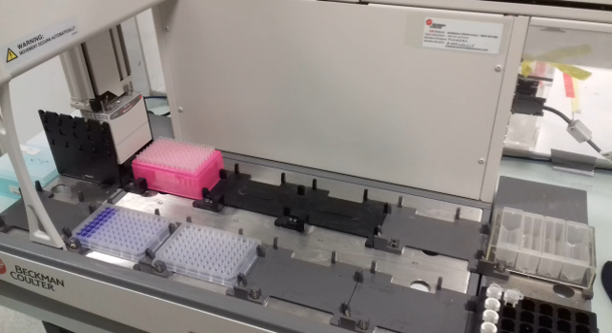
Beckman Biomek I5 with 96 and 384 heads
Hight throughput assays with robotized systems
Beckman Biomek 4000 with 8-wells and mono-well heads

Slide 10
PCML has a panel of assays to find an inhibitor of viral replication
3’
5’
Methyltransferase activity
GpppAC₄ + SAM(³H) -> ³HmGpppAC₄ + SAH
Radioactive assays
(Screen/IC50)
ATPase activity
ATP -> ADP + Pi
Detection of Pi by
Biomolgreen reagent
(luminescence)
(IC50)
capping
Helicase or
NS3
Methyltransferase
replication
NS5
3’
Polymerase
Protein/protein interactions
Detection by HTRF
(Screen/IC50)
Polymerase activity
Poly U + ATP -> Poly U/A or
Poly A + UTP -> Poly A/U
Detection of double strand RNA by
Picogreen reagent (fluorescence)
(Screen/IC50)
5’

Slide 11



MaSC
Viral screening Platform Marseille-Timone (PCVMT)
Scientific manager : Bruno COUTARD
Operational manager : Franck TOURET
Unité des Virus Émergents
(UVE: Aix-Marseille Université – IRD 190 – Inserm 1207 – IHU Méditerranée Infection), Marseille, France

Slide 12
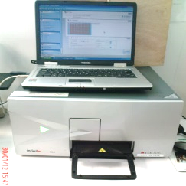
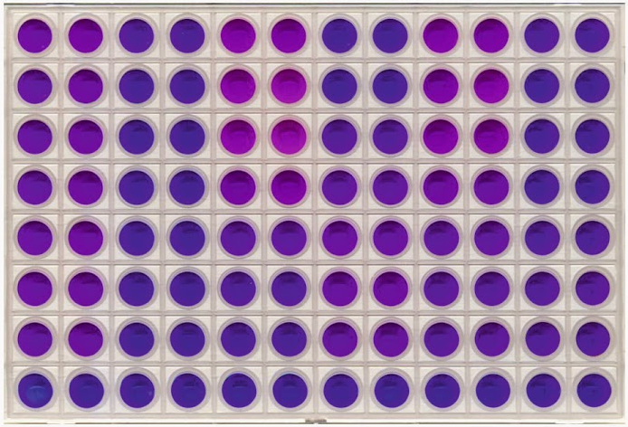


PCVMT : Librairies screening
In cellulo screening with a replicative virus (SARS-Cov-2,Toscana, Tahyna)
Based on the inhibition of the viral induced cytopathic effects
Cell titer blue assay to follow cellular viability
Exemple : Prestwick chemical Library (1520 compounds) screening on SARS-CoV-2
SARS-CoV-2
 | CC |  |  |  |  |  |  |  |  | ARB
 | CC |  |  |  |  |  |  |  |  | ARB
 | CC |  |  |  |  |  |  |  |  | VC
 | CC |  |  |  |  |  |  |  |  | VC
 | CC |  |  |  |  |  |  |  |  | VC
 | CC |  |  |  |  |  |  |  |  | VC
 | CC |  |  |  |  |  |  |  |  | VC
 | CC |  |  |  |  |  |  |  |  | VC
Dilute compound (10µM)
and add to VeroE6
and add virus
(25 µl per wells)
CC: Cell control
VC: Virus control
ARB: Control compound Arbidol
3 days at 37°C, 5% CO₂
Analysis
HITS analysis and selection
Cell Viability assay CTB
In vitro validation by EC50 determination
CTB Reading
at 590 nm
Tecan M200 Pro
Touret et al., 2020
Hernandez et al., 2022

Slide 13
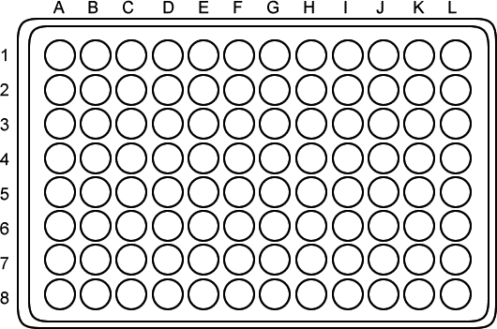
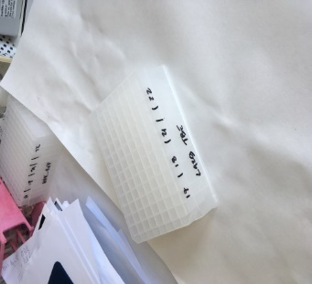
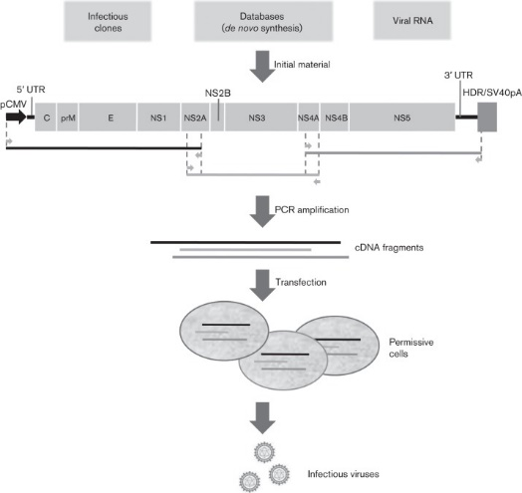
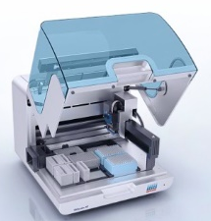
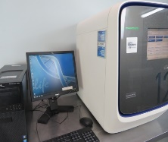

PCVMT : Compounds validation and MoA
Viral replication assay
Available assays on different viral families :
  Flavivirus
    Dengue
    Yellow fever
    Zika
    West-Nile, JEV, TBE
  Alphavirus
    Chikungunya
    « Old world » Alphavirus
    « New world » Alphavirus
  Bunyavirales
    Phlebovirus
    Orthobunyavirus
    Nairovirus
  Coronavirus (SARS-Cov-2)
    - Wuhan, B.1
    -α,β,γ,δ
    -BA.1,2,4,5
    -XBB….
Mode of Action (MoA)
Dispensing of 3 # compounds in 1/2 dilutions from 20 µM to 0,16 µM final
in triplicates (25 µl) then add virus (25 µl)
Virus infection at limiting dilution series of the hit
A
B
C
VC: Virus Control
(no drug,)
CC : mock cell control
(no drug, no virus)
Drug-resistant virus isolate
Sequencing, identification of the viral target
2-4 days
Collect of supernatant in lysis buffer in deep well plates
Validation of the mutation(s) on recombinant virus
Extraction of viral RNA from supernatant
Quantitative real-Time qRT-PCR standardized with T7 Pol-generated synthetic RNA standards
EC50 and EC90 determination
Evaluation of the Cytotoxicity CC50
Aubry, 2014

Slide 14
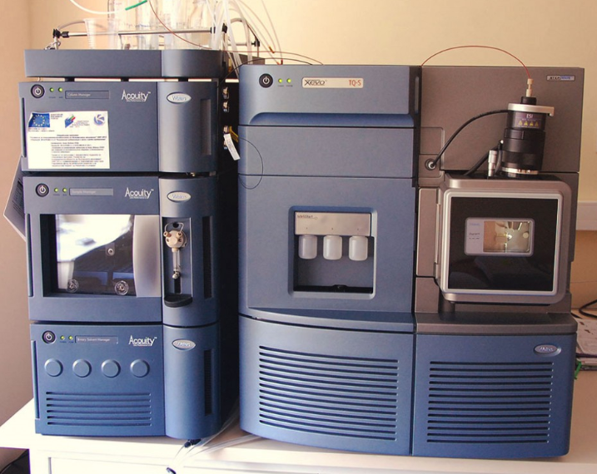
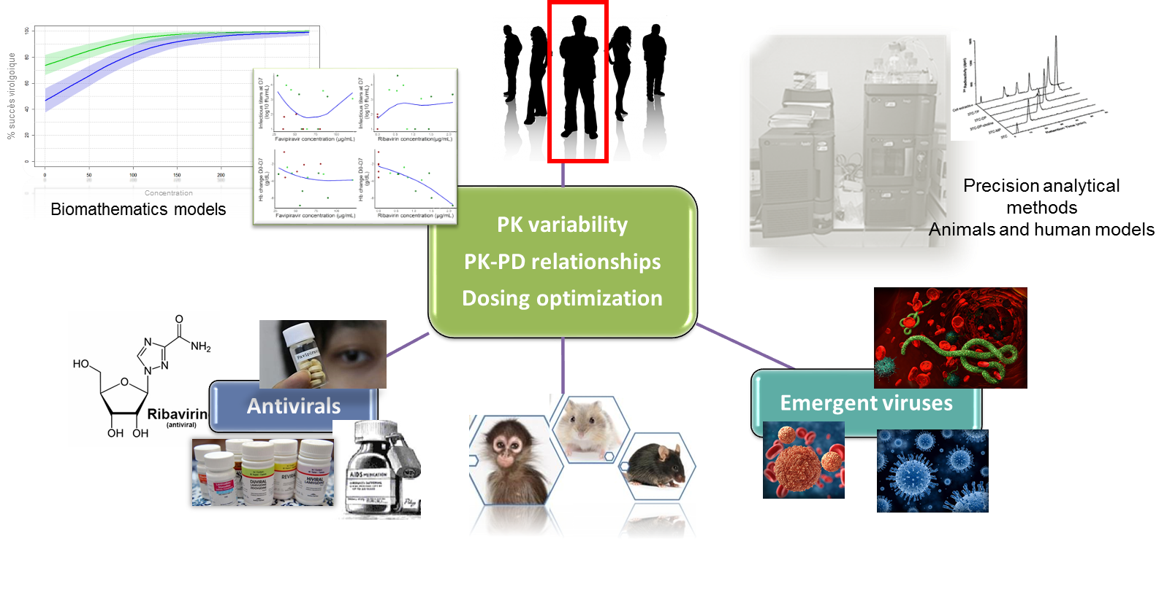
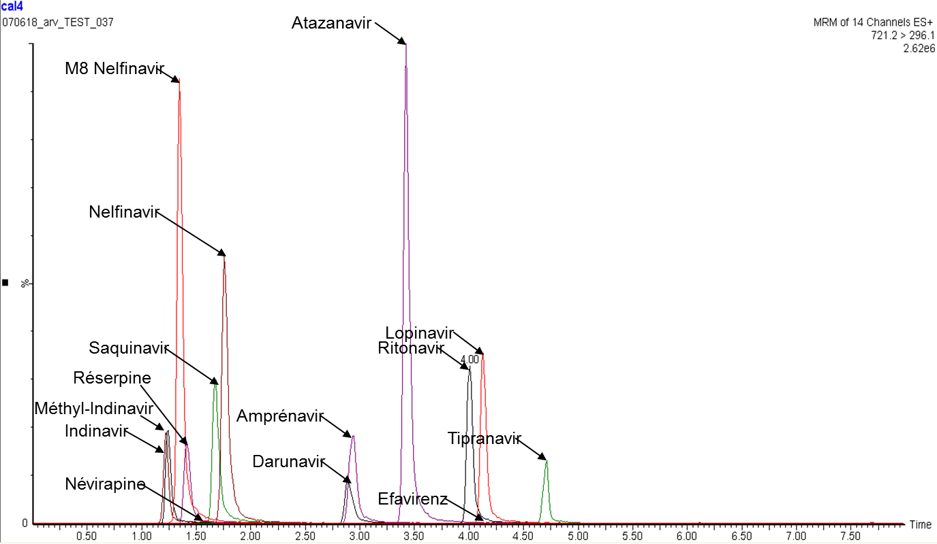
In charge Caroline Solas
Pharmacokinetics of Antivirals
Quantification of antivirals applied to different :
  biologic matrix: blood, plasma/serum, tissues, genital secretion, CSF, …
  species: animals, humans
Using liquid chromatography coupled to tandem mass spectrometry method (LC-MS/MS)
Method validation following EMA/FDA guidelines
Applications: Preclinical and Clinical studies
  Drug pharmacokinetics (PK)
  Characterization of PK variability
  Assess PK-pharmacodynamics (PD) relationships
Validation of an electrospray ionization LC-MS/MS method for quantitative analysis of 11 antiretroviral agents in human plasma samples. Ther Drug Monit. 2009

Slide 15
Example: Mobilization against COVID-19
February 2020
March 2020
April 2020
May 2020
June 2020
Acquisition of a SARS-CoV2 clinical strain trought EVAg
Obtainement of authorization for animal experimentation
Production, characterization and titration of the SARS-Cov-2 strain
Setting up in vitro experiments ( CPE and Molecular biology)
Characterization of several antiviral compounds.
In vitro production-purification of SARS polymerase complex
Development of an in vitro fluorescent high-throughput assay
Validation of the assay on a FDA approuved librairy (Prestwick chemical)
Screening of the Prestwick Chemical library
Hit validation by EC50
Setting up in vivo experiments with Syrian Hamster
Characterization of several antiviral compounds.
In vitro Hits confirmation by IC50 determination
Screening antiviral compounds in vivo (Hit and others)
Characterization of several antiviral compounds.
In vivo and in vitro Screening campaigns (Chimiotheque Nationale…)
Screening antiviral compounds in vivo (Hit and others)
In vitro and in vivo characterization of several antiviral compounds.
Miniaturisation of the in vitro assays (384 wells/1536 wells)
Identification and characterization of hits
SAR/ Hit to lead

Slide 16
Marseille Screening Center
Cover all spectrum of antivirals and anticancer discovery
A unique platform in France
An efficient reactivity
Combine experts in their field of research working for the same objective

