Slide 1
Screening Platform of Marseille-Luminy (PCML)

Slide 2

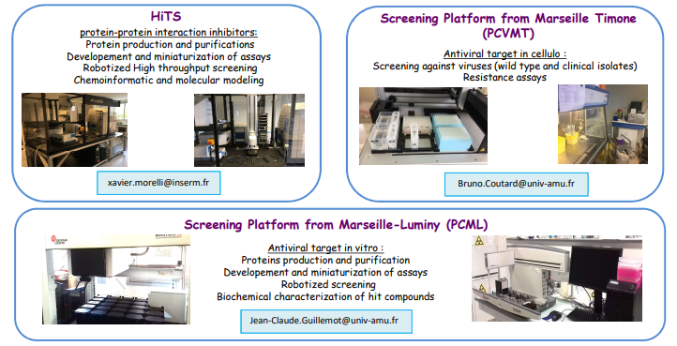
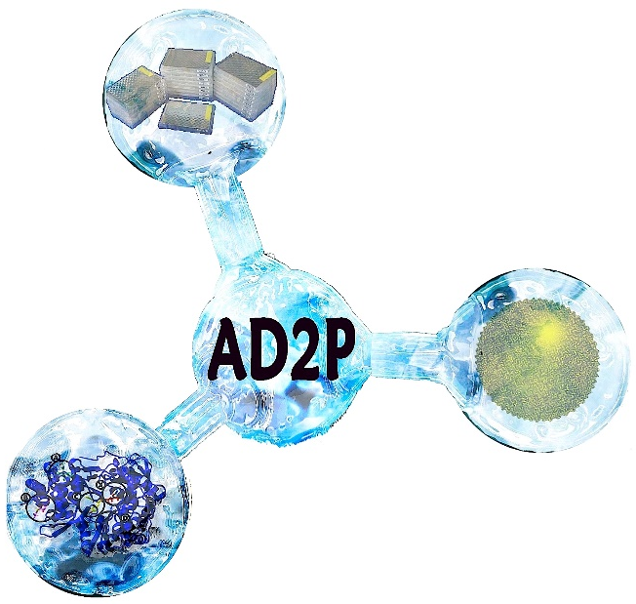






PCML is involved in AD2P and MaSC
Plateforms bringing together 3 sites specializing in screening
AD2P : Antiviral Drug Design Platform
MaSC : Marseille Screening Center
Screening Plateform Marseille-Luminy (PCML)
Jean-Claude GUILLEMOT
Interaction Dynamics
et Drug-Design (INT-3D)
Xavier MORELLI
Viral screening Platform
Marseille-Timone (PCVMT)
Xavier de LAMBALLERIE
Bruno COUTARD
https://www.afmb.univ-mrs.fr/MaSC/

Slide 3

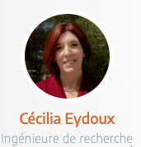

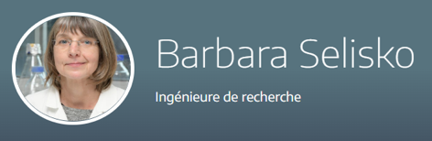
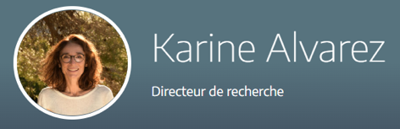

PCML : People
Scientific manager
Operational manager
Production-Purification of proteins
Coordination - Logistic, administration
Chemistry - SAR
Scientific committee member
Internal expert
https://www.afmb.univ-mrs.fr/facility/plateforme-de-criblage-marseille-luminy/

Slide 4
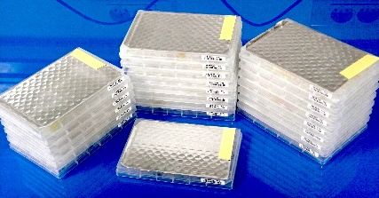
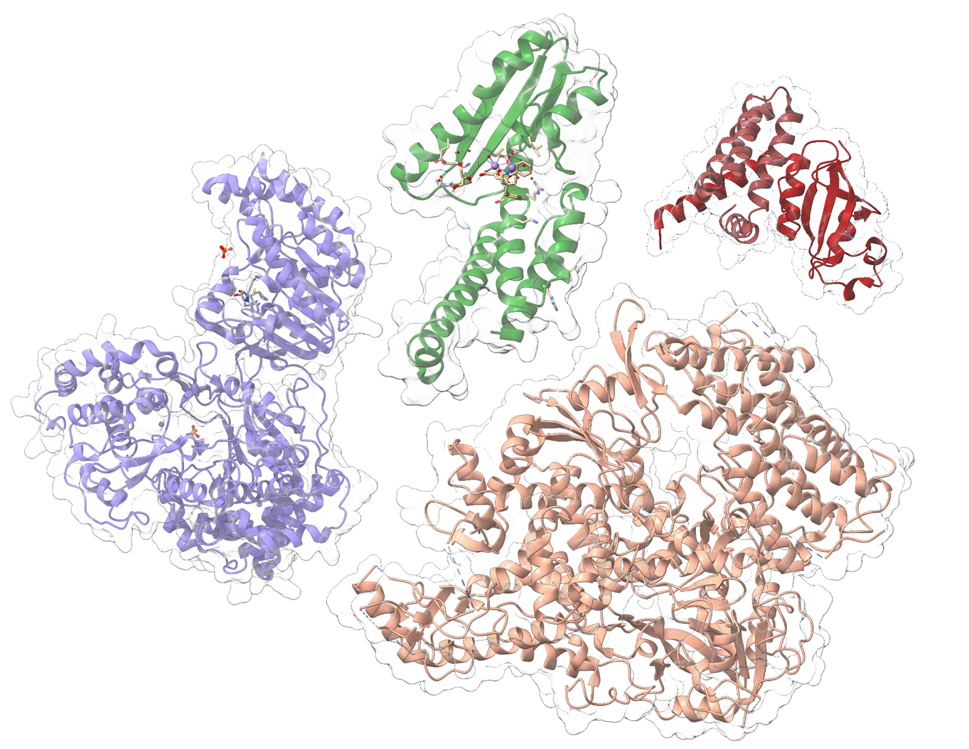
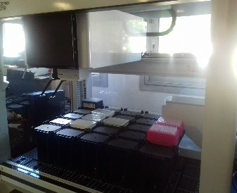
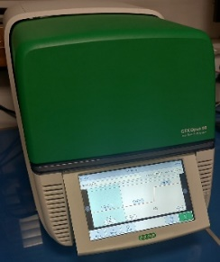
Expertise and know-how of PCML
Chemical libraries
>76 000 compounds
Academic and commercial librairies
PCML
Enzymes library
Production and purification of
target proteins
(Flavivirus and Coronavirus)
Screening – IC50
Fluorescent and radioactive assays on robotized systems
Orthogonal Assays
- IC50s with detergent
- Thermalshift assay

Slide 5

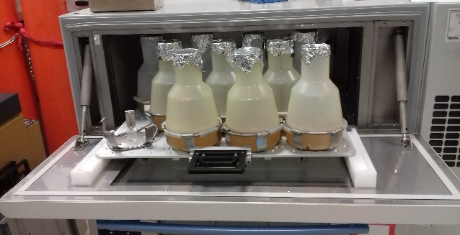
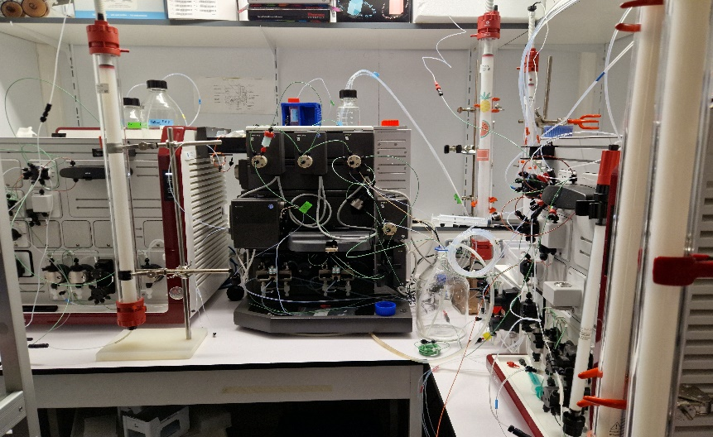
Enzyme library
Flavivirus
Coronavirus (1&2)
18* NS5 full
PCML
Nsp12
6* MTase
Nsp8
10* RdRp
Medium to High
throughput assays
Nsp8L7 (CoV2)
Nsp7L8 (CoV1)

Slide 6
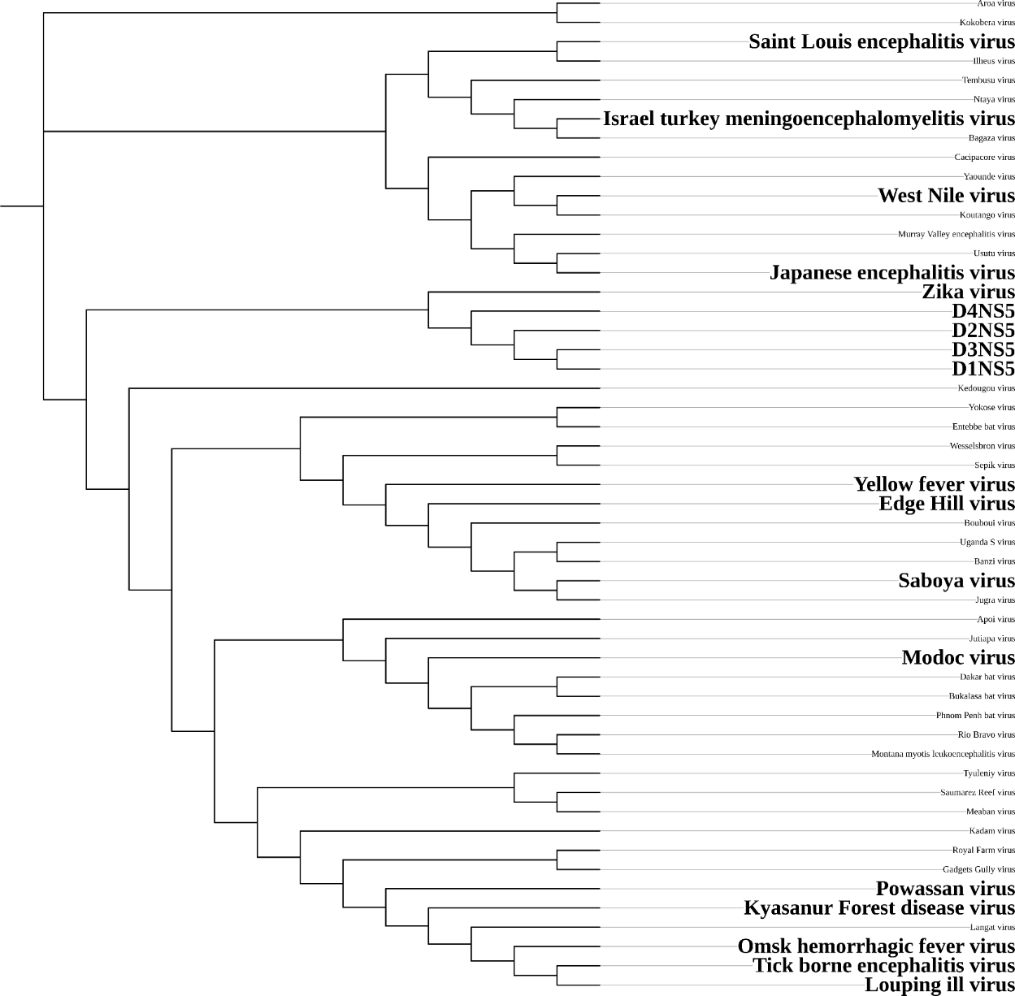
Enzyme library
Flavivirus
NS5
2 – 15 mg
MTase
0,9 – 15 mg per liter of culture
RdRp
0,1 – 19 mg

Slide 7
Enzyme library
Bunyavirales
(LCMV, Lassa,Toscana,
Rift valley fever virus…)
Coronavirus (1&2) (MERS,SARS)
Nsp14 (ExoN)
11* EndoN
Nsp7
3* ExoN
Nsp15 (EndoU)
L – protein
Nsp9
Retro-Virus (HIV)
Nsp3 (Macro and Protease)
Reverse transcriptase
Viral team
Arteriviridae (EAV)
Mononegavirales (RSV)
Nsp9
RdRp, Mtase
Nsp6 , Nsp 7
Alpha-like Viruses
(VEEV-HEV-Chik)
Picornaviridae (Cox,Polio)
Low
throughput assays
(characterization,
mode of action)
RdRp, Helicase
Nsp1
Others Flaviviridae (HCV, BVDV)
ORF-1 : Hel, Macro, Mtase
NS5b

Slide 8

Chemical libraries
More than 76 000 compounds are availables from academic and commercial libraries
Prestwick library (chemical, natural, pyridazin)
National Cancer Institute diversity (NCI) library
ChembridgeTM « Diversity set » library
French National Library divided into :
Strasbourg library
Curie Institute library
Gif sur Yvette ICSN library
Caen library
Active sightTM fragment based library
Medecines for Malaria Venture (MMV) library (Pandemic and GHP)
Libraries dedicated to the inhibition of the interaction protein/protein or protein/peptide :
2P2I3D
Fr-PPICHem
Life chemical rule of four
Part of the ChemDiv Eccentric
Fragments library
Plates size :
96 wells
384 wells
1536 wells (NS5 DV, Sars CoV)

Slide 9

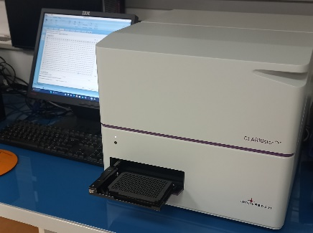
Screening – IC50
3’
5’
Methyltransferase activity
GpppAC₄ + SAM(³H) -> ³HmGpppAC₄ + SAH
Radioactive assays
(Screen/IC50)
ATPase activity
ATP -> ADP + Pi
Detection of Pi by
Biomolgreen reagent
(luminescence)
(IC50)
capping
Helicase or
NS3
Methyltransferase
replication
NS5
3’
Polymerase
Protein/protein interactions
Detection by HTRF
(Screen/IC50)
Polymerase activity
Poly U + ATP -> Poly U/A or
Poly A + UTP -> Poly A/U
Detection of double strand RNA by
Picogreen reagent (fluorescence)
(Screen/IC50)
5’

Slide 10
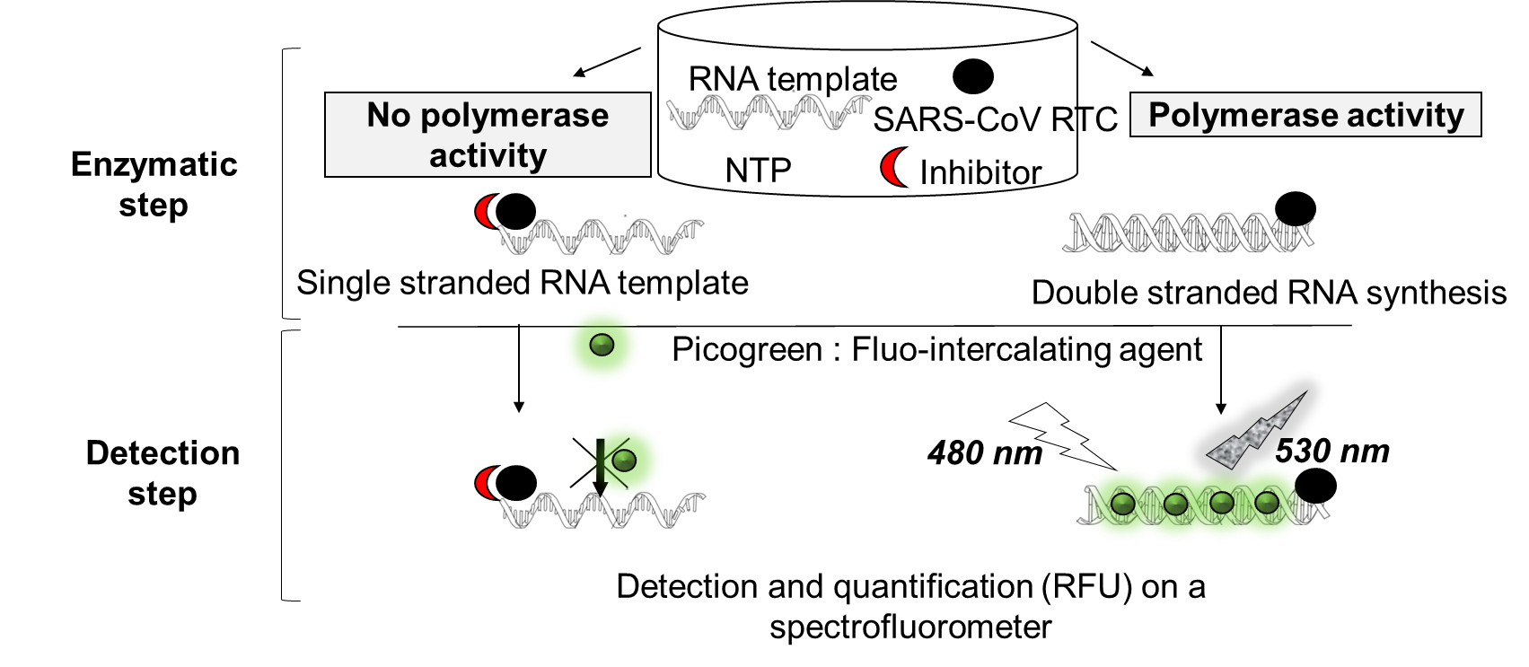
Screening – IC50
Example on SARS Cov-2 replication complex
Screen at 20 et 5 µM
Hits validation (IC50)
Orthogonal assays :
IC50 with detergents
Thermalshift assays (TSA)
 | ID | Number of Compounds | Hit rate | Z'
Prestwick | Chemical | 1520 | 3.02% | 0,8
 | Natural | 320 | 9.7% | 0,75
 | Pyridazine | 400 | 2.2% | 0,78
Academic | PPI-Chem | 10 314 | 0.75% | 0,85
 | CNE | 1040 | 3.4 % | 0,8
 | Virtual screen | 618 | 0,30% | 0,84
Pharma Y | Virtual screen | 150 | 0% | 0,8
Pharma J | virtual screen | 129+2839 | 0 to 1,2% | 0,75
Pharma P | Virtual screen | 4996 | (0,1 to 0,04%) | 0,78
 |  | 22 326
SAR studies, hits optimisation
(analogues)
Specificity,
Characterization (MOA)
Cellular assays
Soaking/Co-cristallisation
Cryo-EM

Slide 11
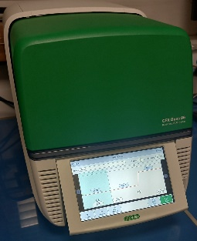
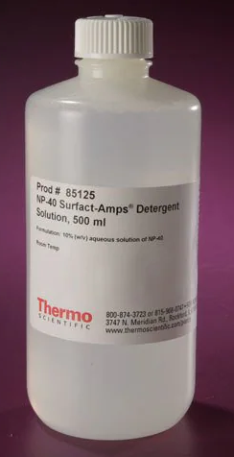
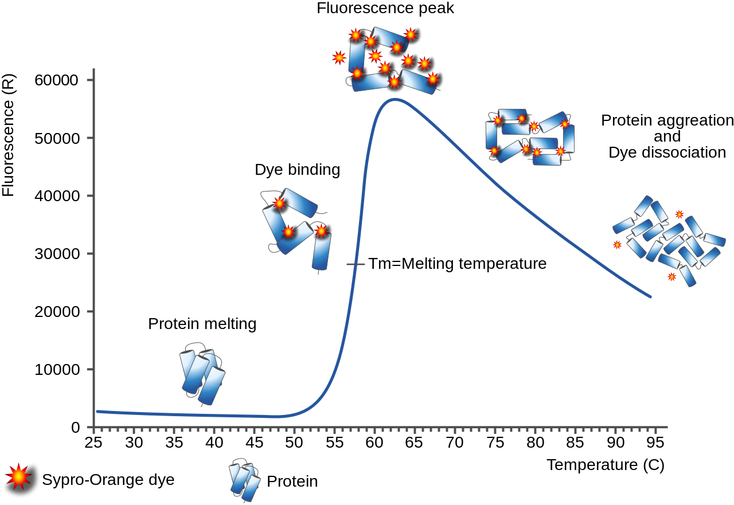


Orthogonal assays
Thermal shift assay (TSA)
Validation of the compound/protein interaction (Kd_{app})
Help to cristalogenesis, cryo-EM…
IC50 with and without detergent
(agregator,unspecific binding…)
Compound 1
Compound 2
IC50 = 19,3 µM
IC50 = 3 µM
With NP40
IC50 = 7,7 µM
Loss of inhibition in presence of NP40

Slide 12
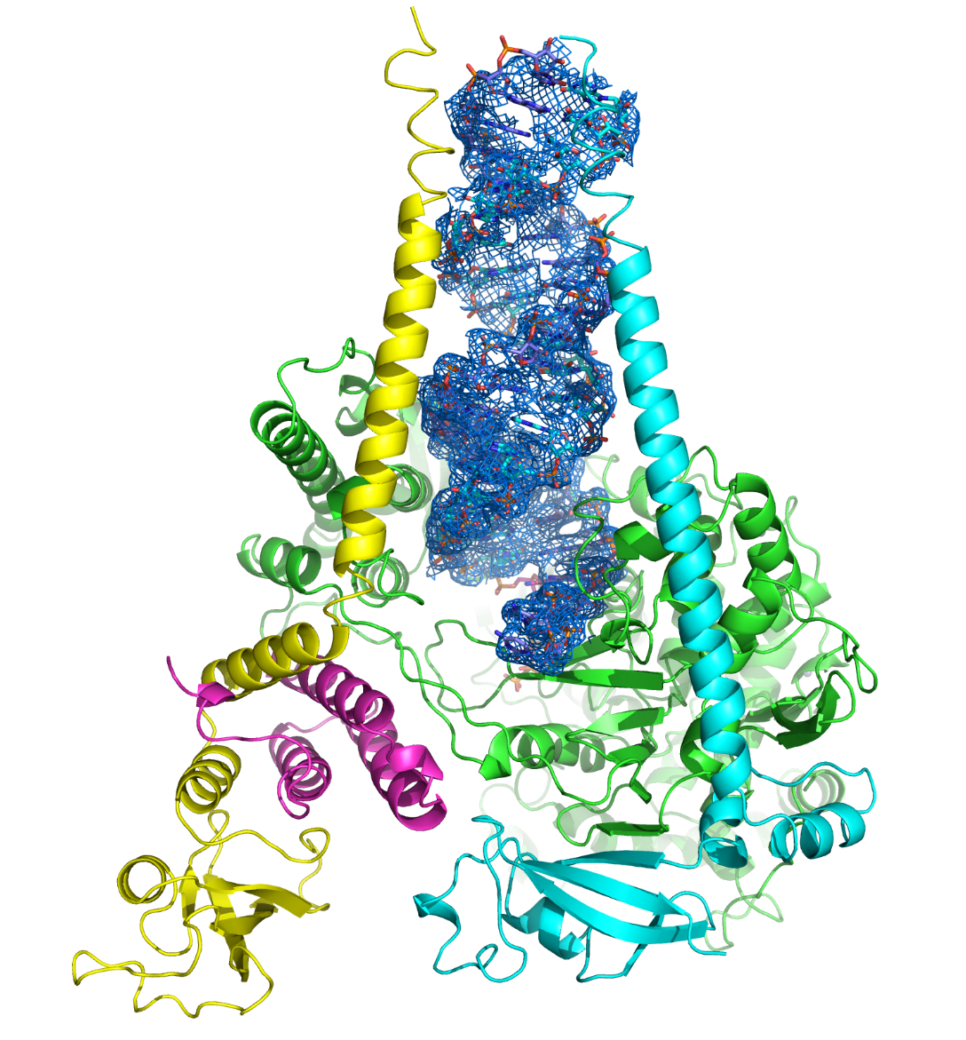
Orthogonal assays
Simplify mapping of hits on the SARS-CoV2 RTC by TSA assay
RNA
Hit A
Hit B
nsp8
nsp8
Strong binding
No binding
nsp12
nsp12
RdRp
nsp7
Linker =
nsp8L7
Medium binding
Low binding
(nsp12 + nsp8L7)
complex
nsp8
Cryo-EM structure at 2.98 A resolution Shannon et al., Nat. Comm. 2022
-> Hit A : Cryo-EM and co-cristalization are on going

Slide 13
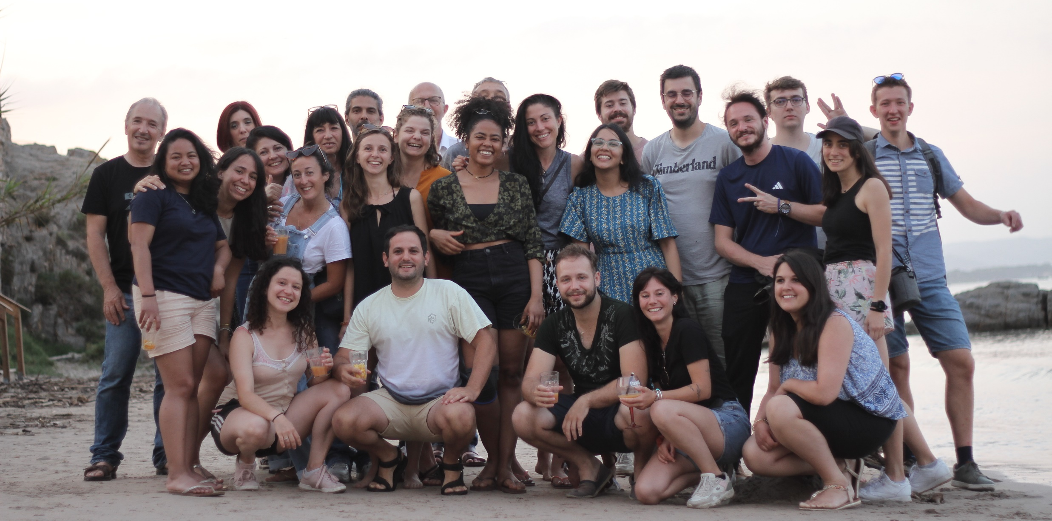
AFMB Viral Replicases : Structure, Function and Drug-designTeam

